Slide 1


Logical Operators in SQL
Fundamentals and Background
Notes:
Logical Operators in SQL are used to check if a statement is true or false.

Slide 2
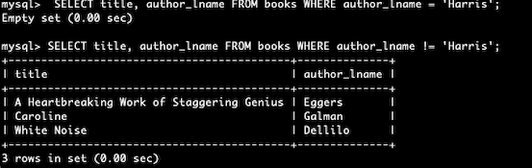
Logical Operators
equal/ not equal checks if two expressions are equal or not. The syntax is:
select * from <table name>
where< column name> = or != <expression>;
For example:
.
Notes:
equal/ not equal checks if two expressions are equal or not. The syntax is :select * from <table name> where< column name> = or != <expression>;

Slide 3
Logical Operators (count.)
like/not like checks if two expressions are like each other or not. The syntax is:
select * from <table name>
where< column name> like or not like <expression>;
Notes:
like/not like checks if two expressions are like each other or not. The syntax is: select * from <table name> where< column name> like or not like <expression>;

Slide 4
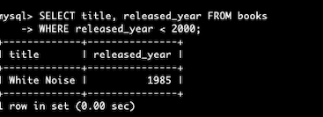
Logical Operators (count.)
greater than/ less than checks if two expressions are greater than or less than each other. The syntax is:
select * from <table name>
where< column name> < or > <expression>;
For example:
Notes:
greater than/ less than checks if two expressions are greater than or less than each other. The syntax is: select * from <table name> where< column name> < or > <expression>;

Slide 5
Logical Operators (count.)
and returns if all the conditions are met. The syntax is:
select <column name> from <table name>
where <condition 1> and <condition 2>;
Notes:
and returns if all the conditions are met. The syntax is: select <column name> from <table name> where <condition 1> and <condition 2>;

Slide 6
Logical Operators (count.)
or returns if any of the conditions are true. The syntax is:
select <column name> from <table name>
where <condition 1> or <condition 2>;
Notes:
or returns if any of the conditions are true. The syntax is: select <column name> from <table name> where <condition 1> or <condition 2>;

Slide 7
Logical Operators (count.)
between returns values that in the range of each other. The syntax is:
select <column name> from <table name>
where <column name> between <condition 1> and <condition 2>;
Notes:
between returns values that in the range of each other. The syntax is: select <column name> from <table name> where <column name> between <condition 1> and <condition 2>;

Slide 8
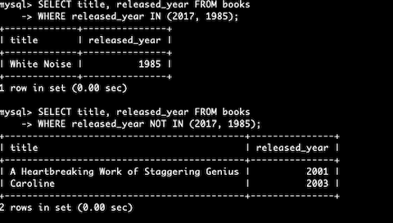
Logical Operators (count.)
in/not in returns values that are present in the arguments or not. The syntax is:
select <column name> from <table name>
where <column name> in or not in <value>;
For example:
Notes:
in/not in returns values that are present in the arguments or not. The syntax is: select <column name> from <table name> where <column name> in or not in <value>;

